Slide 1
Welcome To
Presentation

Slide 2

Project Title
Hawk Eye
The Intelligent Surveillance System

Slide 3








Slide 4
Hawk Eye: The Intelligent Surveillance System
Presented by:
Rejaul Karim (41)
Shaeed Al Hasan (42)
Sima Akter (07)
Abdullah Al Shuvo (31)
Department of Computer Science & Engineering
Dhaka International University
Supervised by:
Md. Rafid Mostafiz
Lecturer
Department of Computer Science & Engineering
Dhaka International University

Slide 5
Overview
Video monitoring system is very popular, significant and useful for surveillance system in a commercial building. However, conventional video monitoring system based surveillance system has several weakness. Such as find out anyone’s movement is very long time process, or identifying unknown person is very hard for security in charge.
This project is aimed to use new technology-based solution to overcome from those problem. It implemented facial recognition for recognized coming person in CCTv covered area. The human face is being identified using the Histogram of Oriented Gradients (HOG) method. Deep CNN Neural Network was trained to get unique measurements from the human face, and Support Vector Machine (SVM) for face identification. After recognized a person this system will trace all movement of this person. And the system is able to detecting unauthorized access of of human.
Finally, a prototype using a desktop application the entire system managed, a web application and android mobile application was used to remote access to the server and a webcam was used for simulation.

Slide 6
Programming Language and tools
Languages and Database
Python 3
Java
TypeScript
JavaScript
HTML
CSS
XML
MySql
Frameworks and Library
OpenCV2
PIL
Dlib
tkinter
Spring Boot
Angular 10
Android Native Library
Bootstrap 4

Slide 7
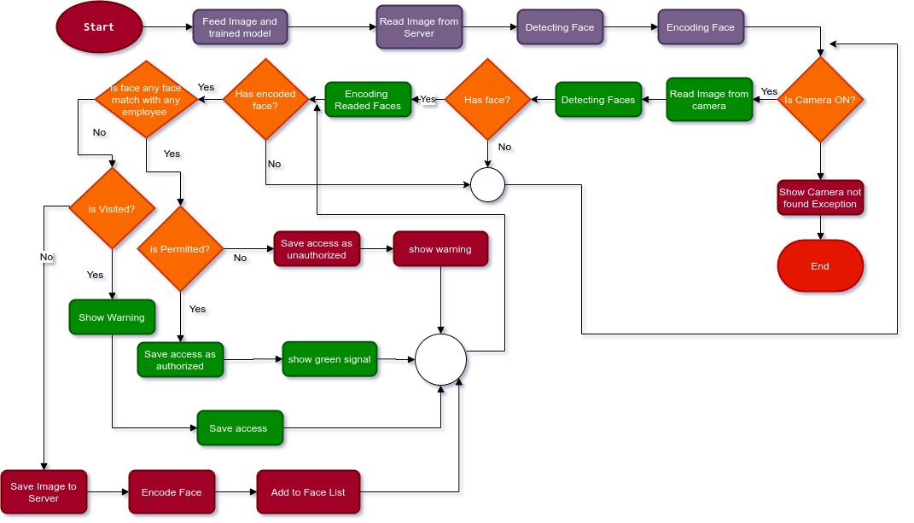
Flowchart

Slide 8
Let’s have a look how it works
The Intelligent Surveillance System

Slide 9
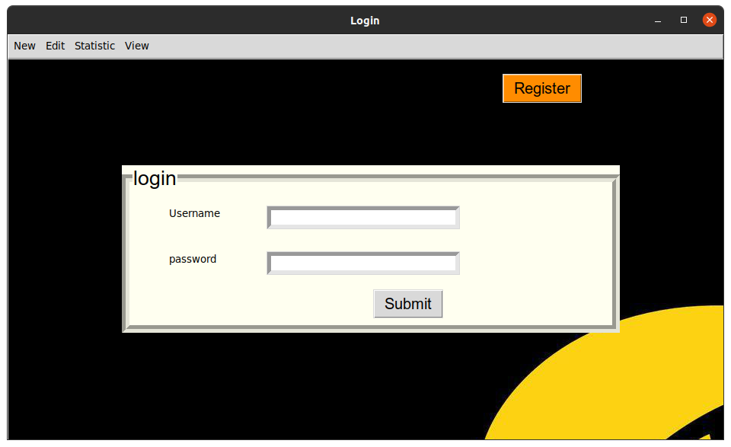
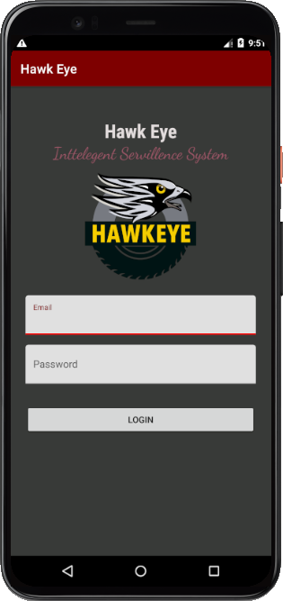
Login

Slide 10

Login

Slide 11
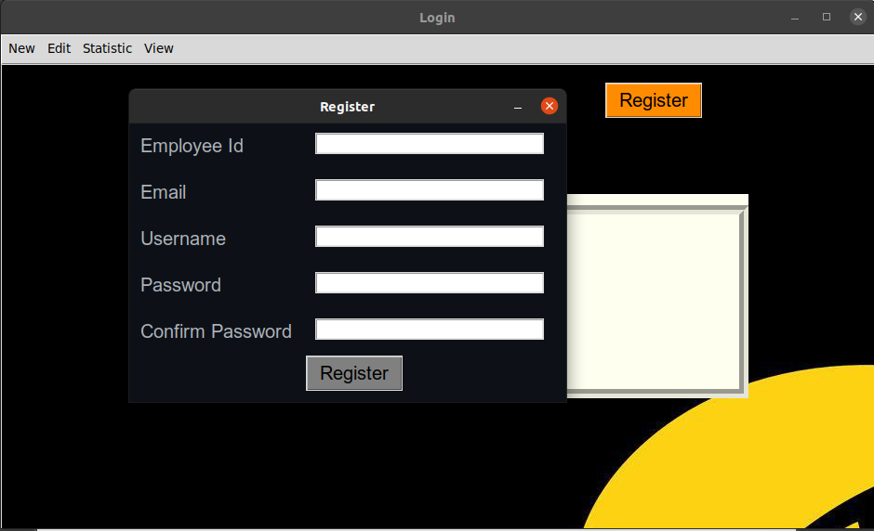
User Registration

Slide 12
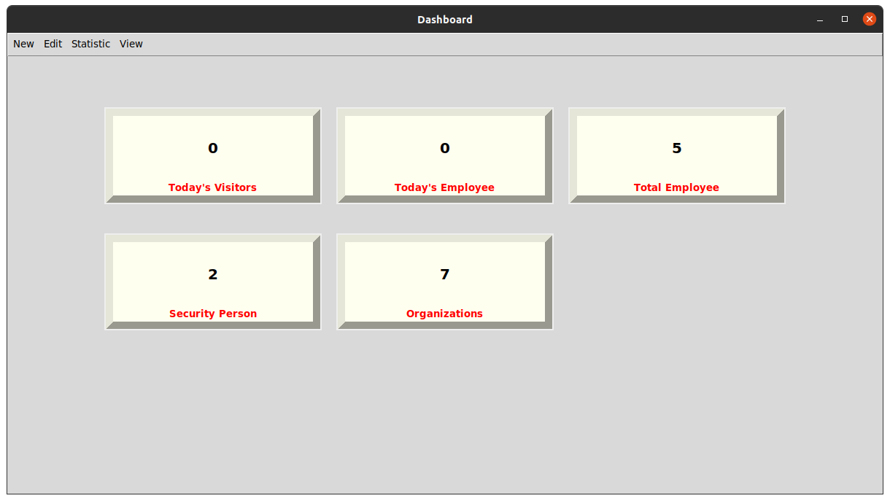
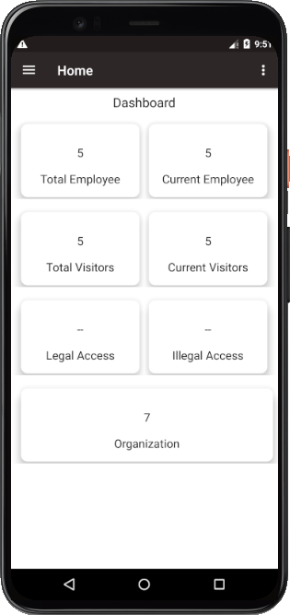
Dashboard

Slide 13
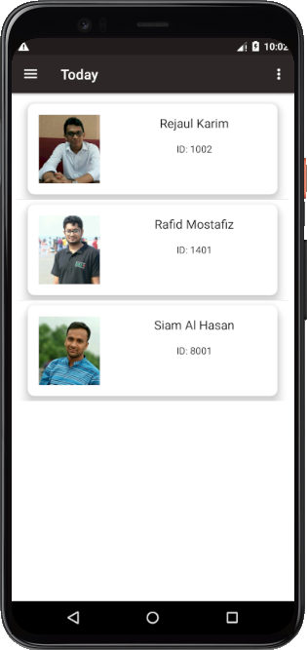
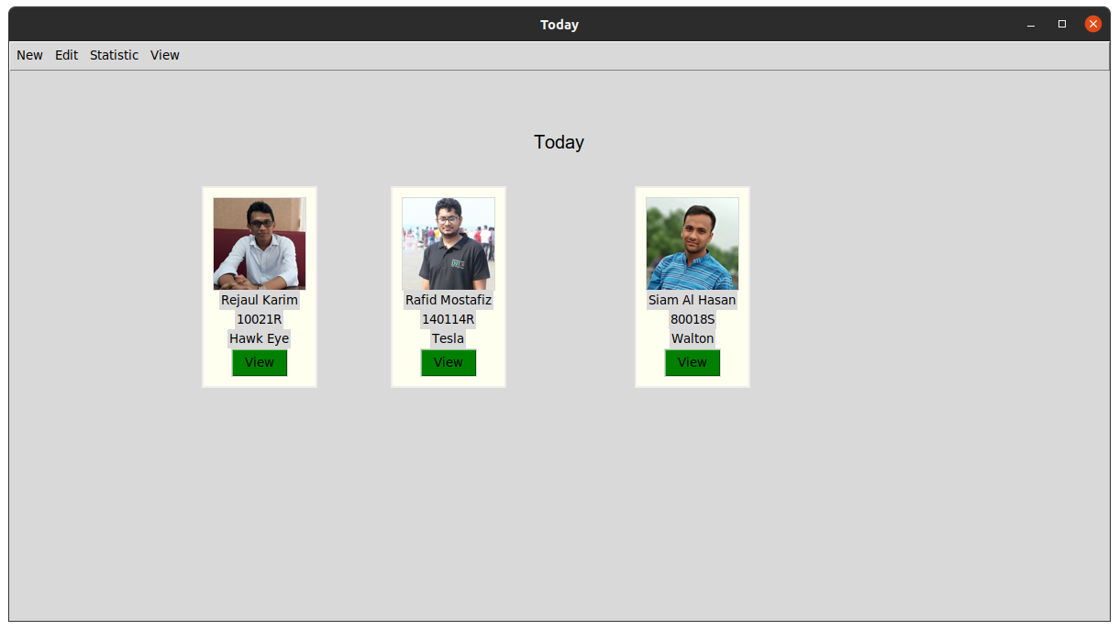
Today Access

Slide 14
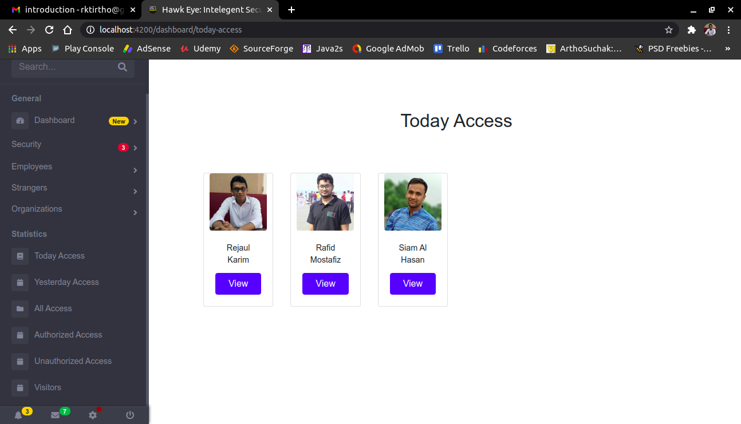
Today Access

Slide 15
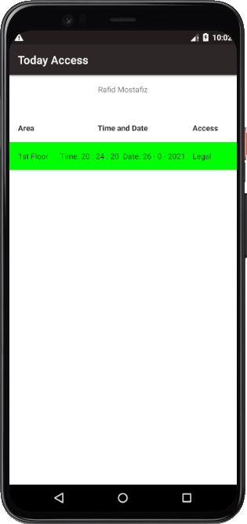
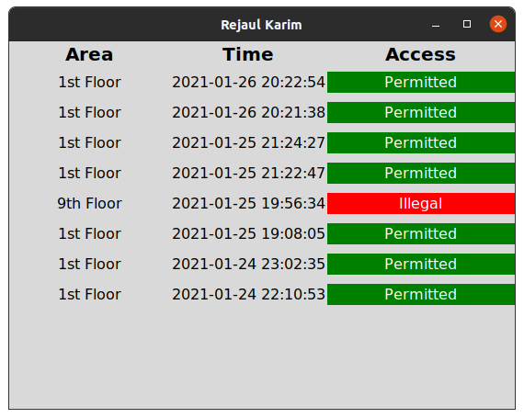
Today Access View

Slide 16
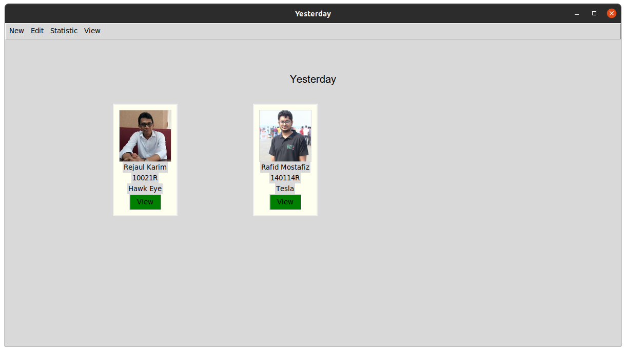
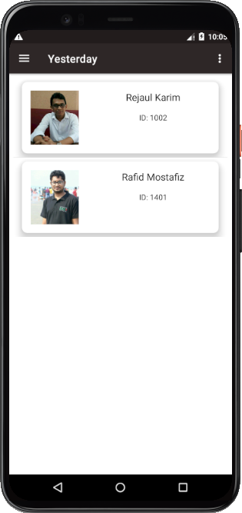
Yesterday Access

Slide 17
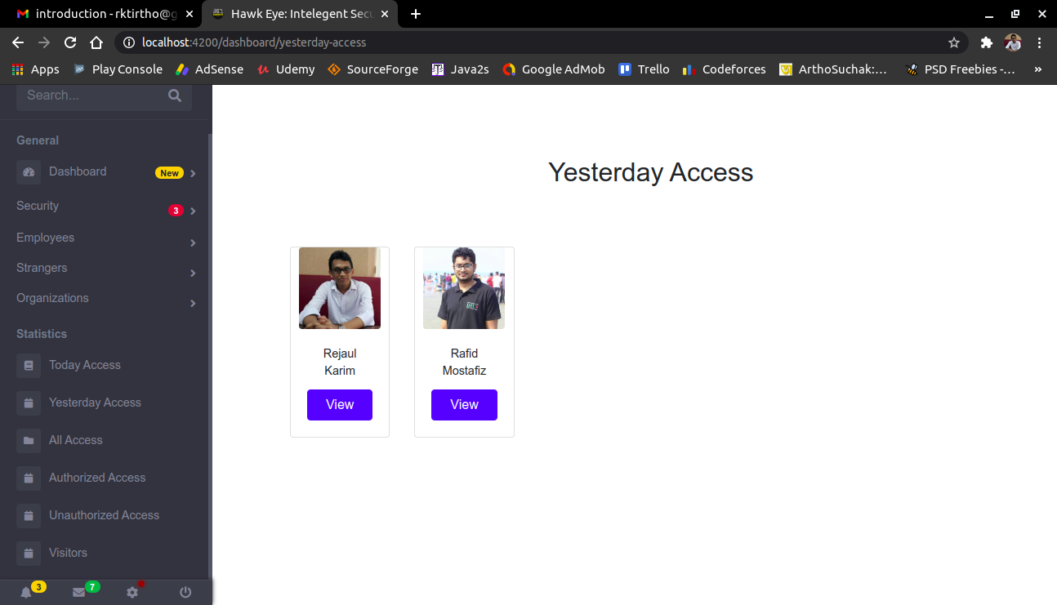
Yesterday Access

Slide 18
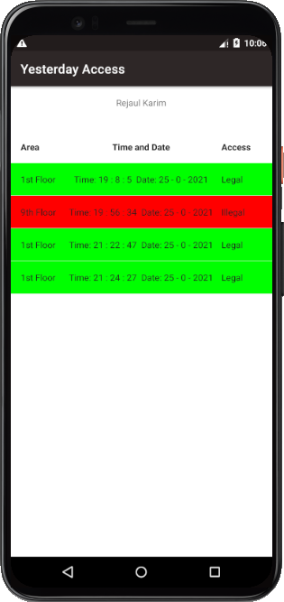
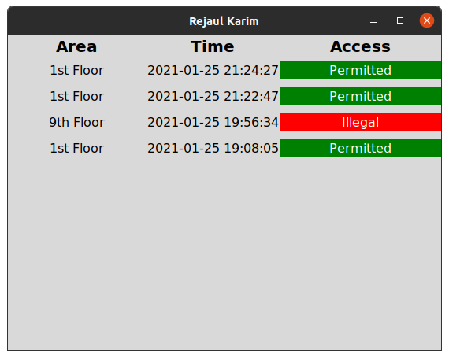
Yesterday Access View

Slide 19
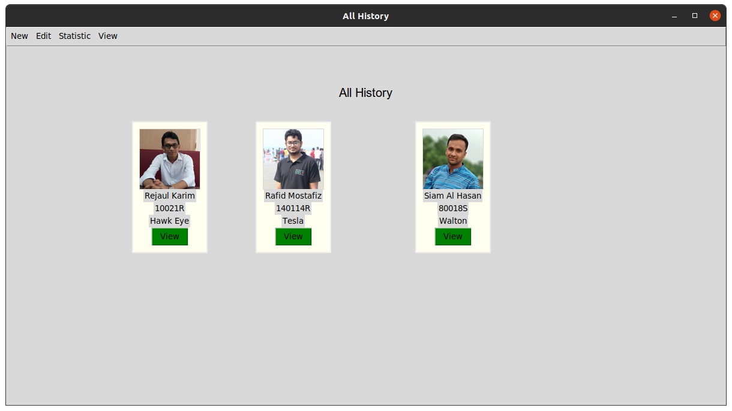
All Access

Slide 20
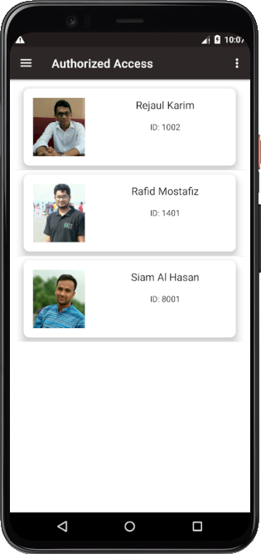
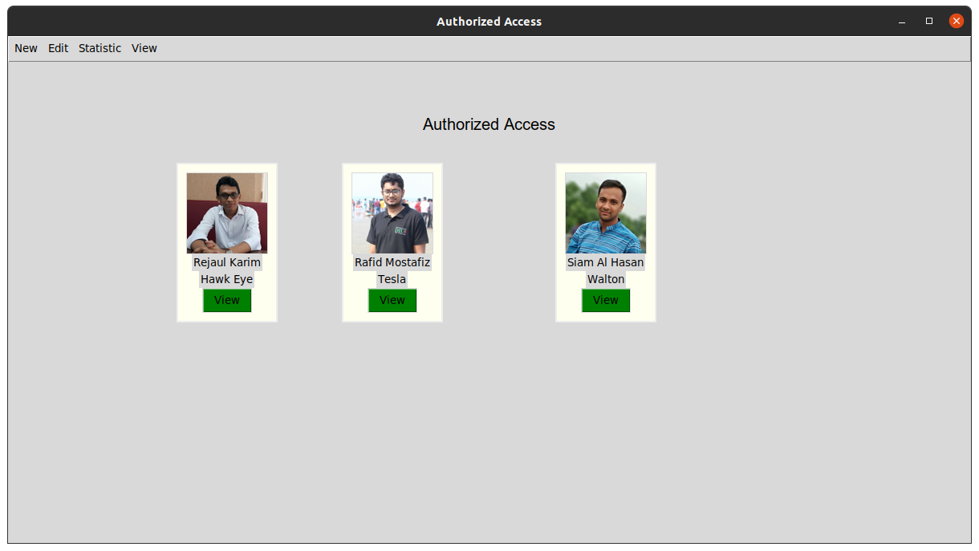
Authorized Access

Slide 21

Authorized Access

Slide 22
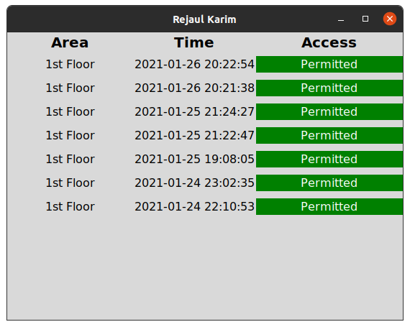
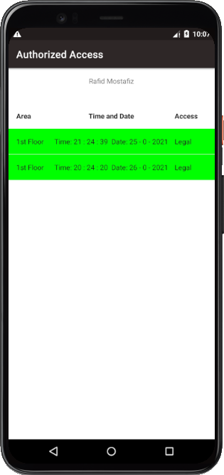
Authorized Access View

Slide 23
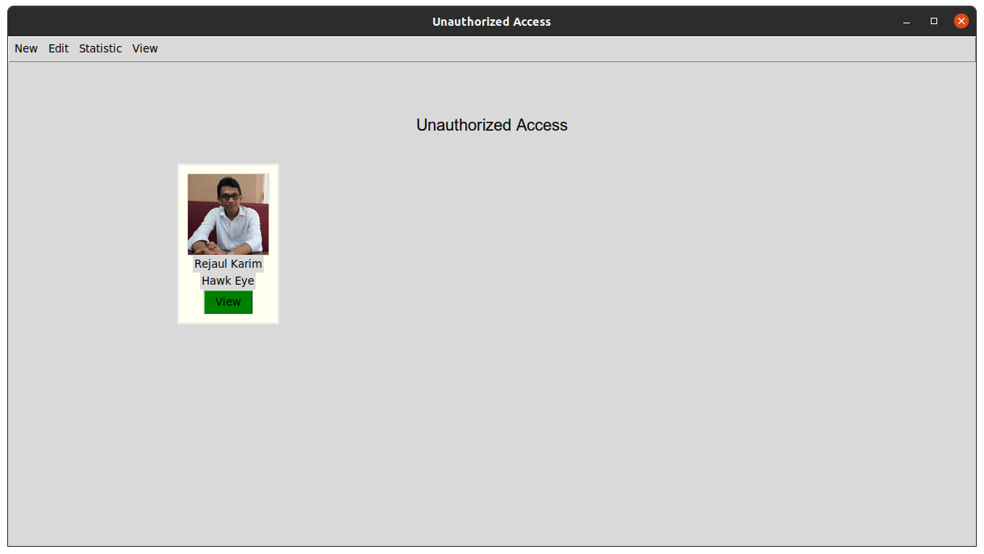
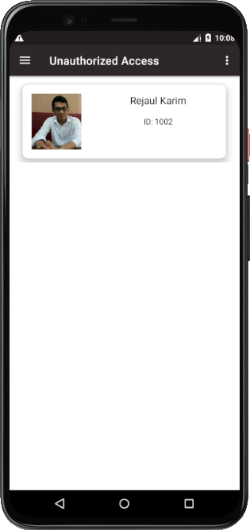
Unauthorized Access

Slide 24
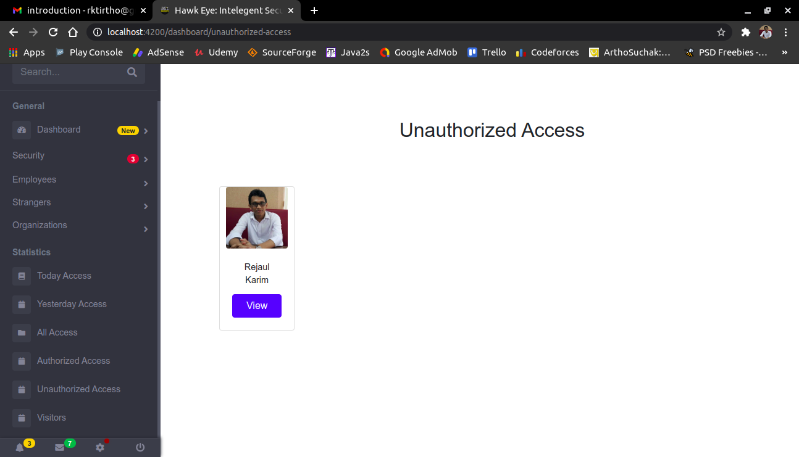
Unauthorized Access

Slide 25
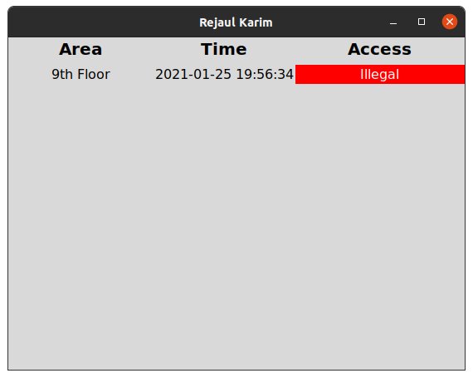
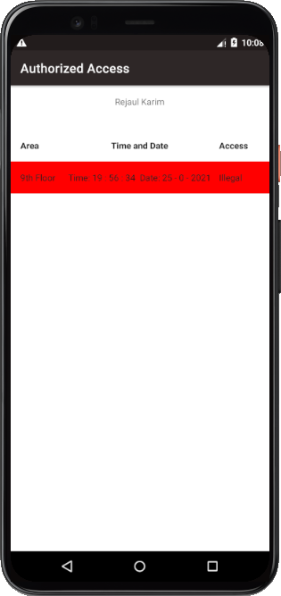
Unauthorized Access View

Slide 26
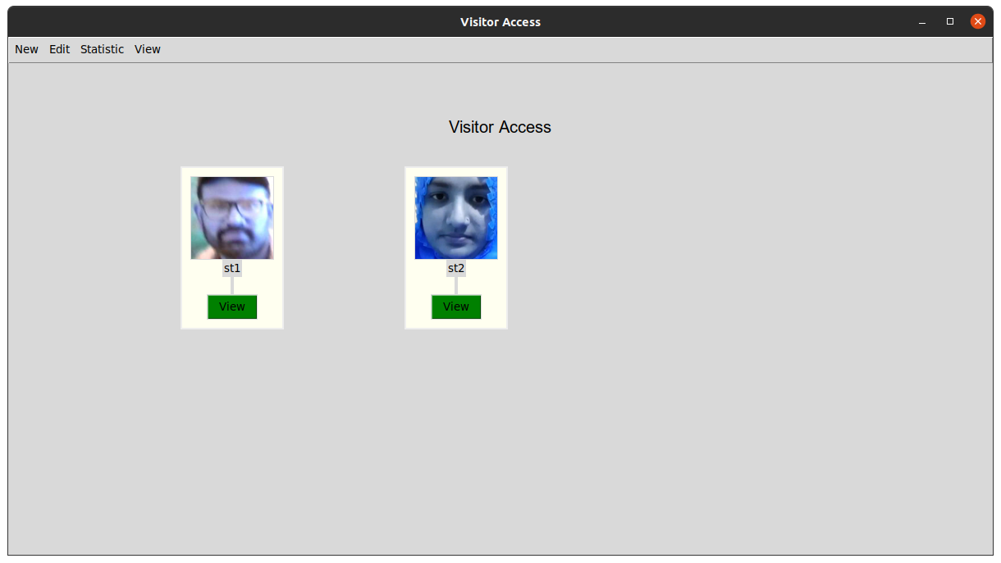
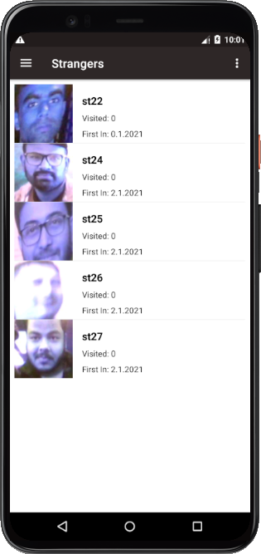
Visitors

Slide 27
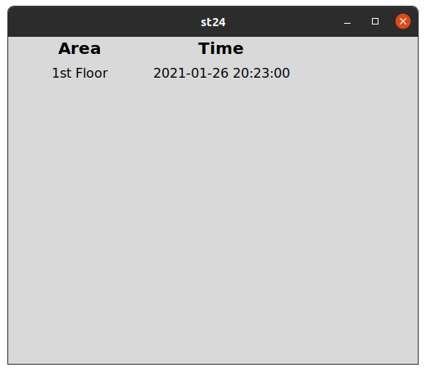
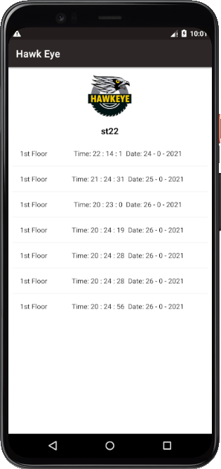
Visitor Access

Slide 28
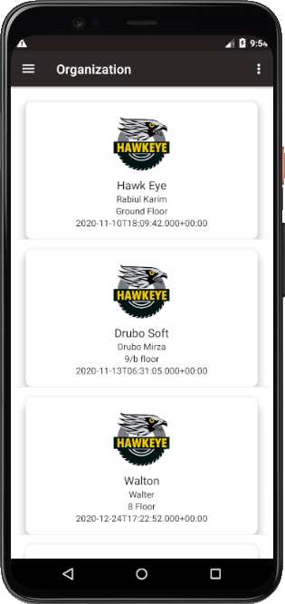
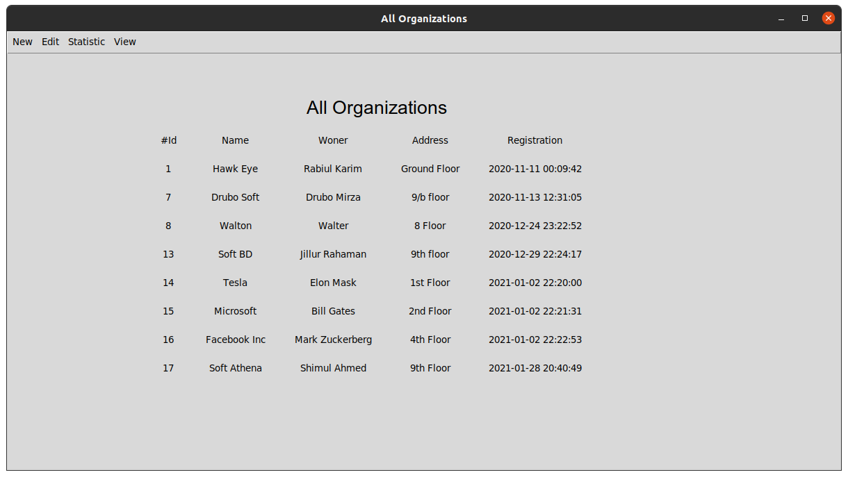
Organizations

Slide 29
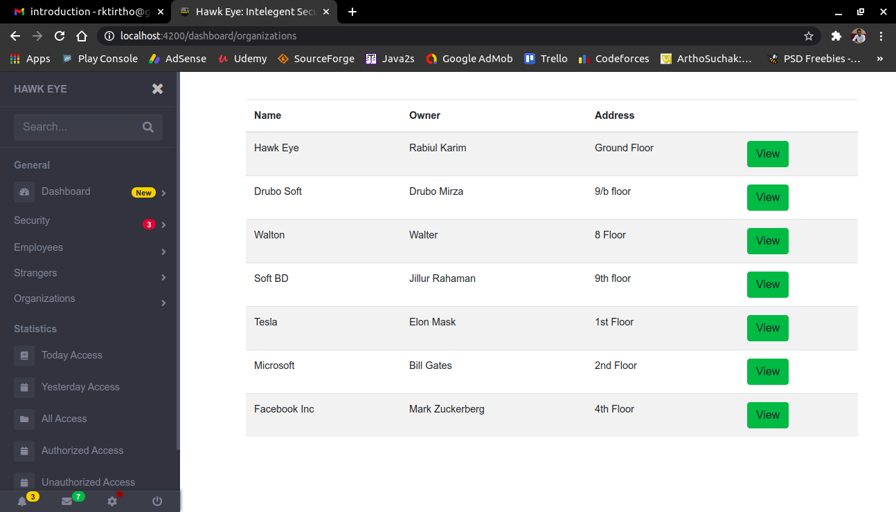
Organizations

Slide 30
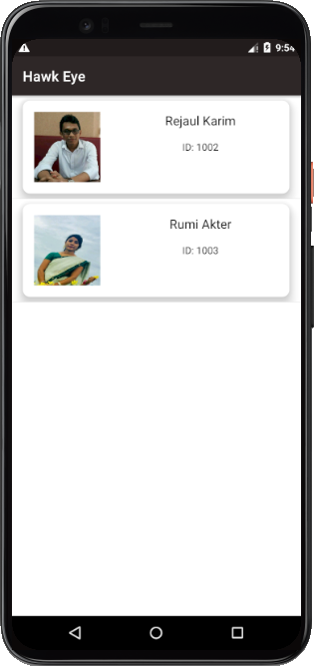
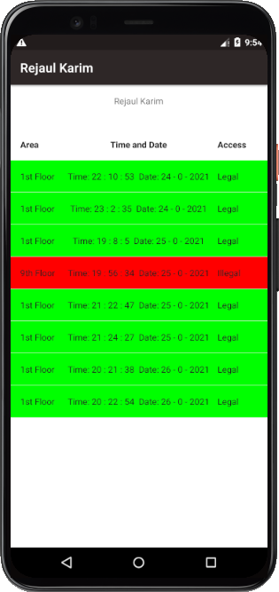
Employee Of Organization

Slide 31
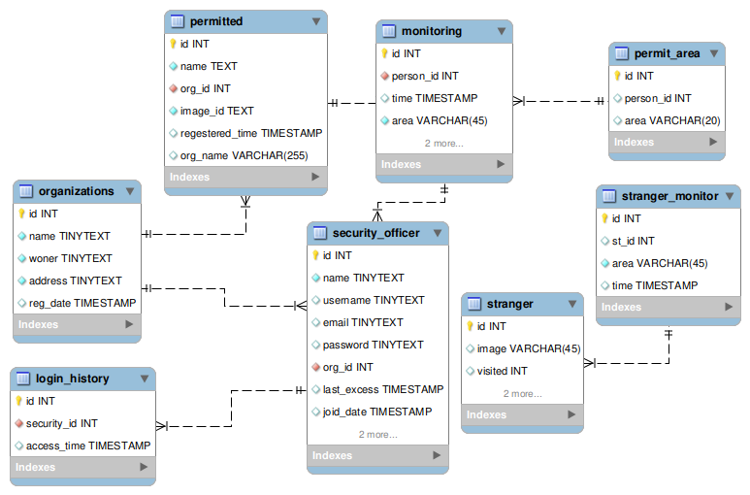
Data Flow Diagram

Slide 32
Objective
Fast Monitoring.
Monitoring Human movement.
Recognized Employee and Visitors.
Recognized Authorized and Unauthorized access.
Real Time Data monitoring.

Slide 33
Application
Commercial Building
Nuclear Power Plant
Industry, Mail, Fectory
Confidential Project
Residential Area
Scientific Research Center
National Surveillance System

Slide 34
Requirements
Computer
Android Mobile
Dedicated server
CCTv Camera
DVR/NVR
Web Server

Slide 35
Limitations
Failed to distinguish identical twins.
Failed to distinguish Plastic surgery
Unable to detect masked face.
Failed to distinguish photo face and real face.

Slide 36
Future Work
Make a complete package of Surveillance System include blockchain security.
Integrate Gait recognition to overcome the limitations of face recognition.

Slide 37
Thank You

